Slide 1
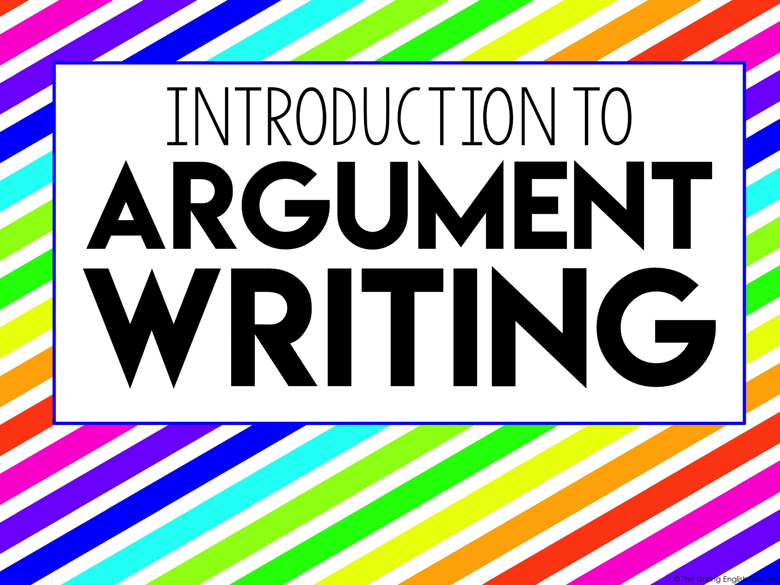
Introduction to
Argument Writing

Slide 2
What is Argument Writing?
An argument essay is a piece of writing that provides information AND presents an argument that includes the supporting and opposing ideas.

Slide 3
What is Argumentative Writing?
The goal, or objective, of an argumentative essay is to convince your audience that your claim, or opinion, is valid.
People have been writing argumentative pieces for a long time.

Slide 4
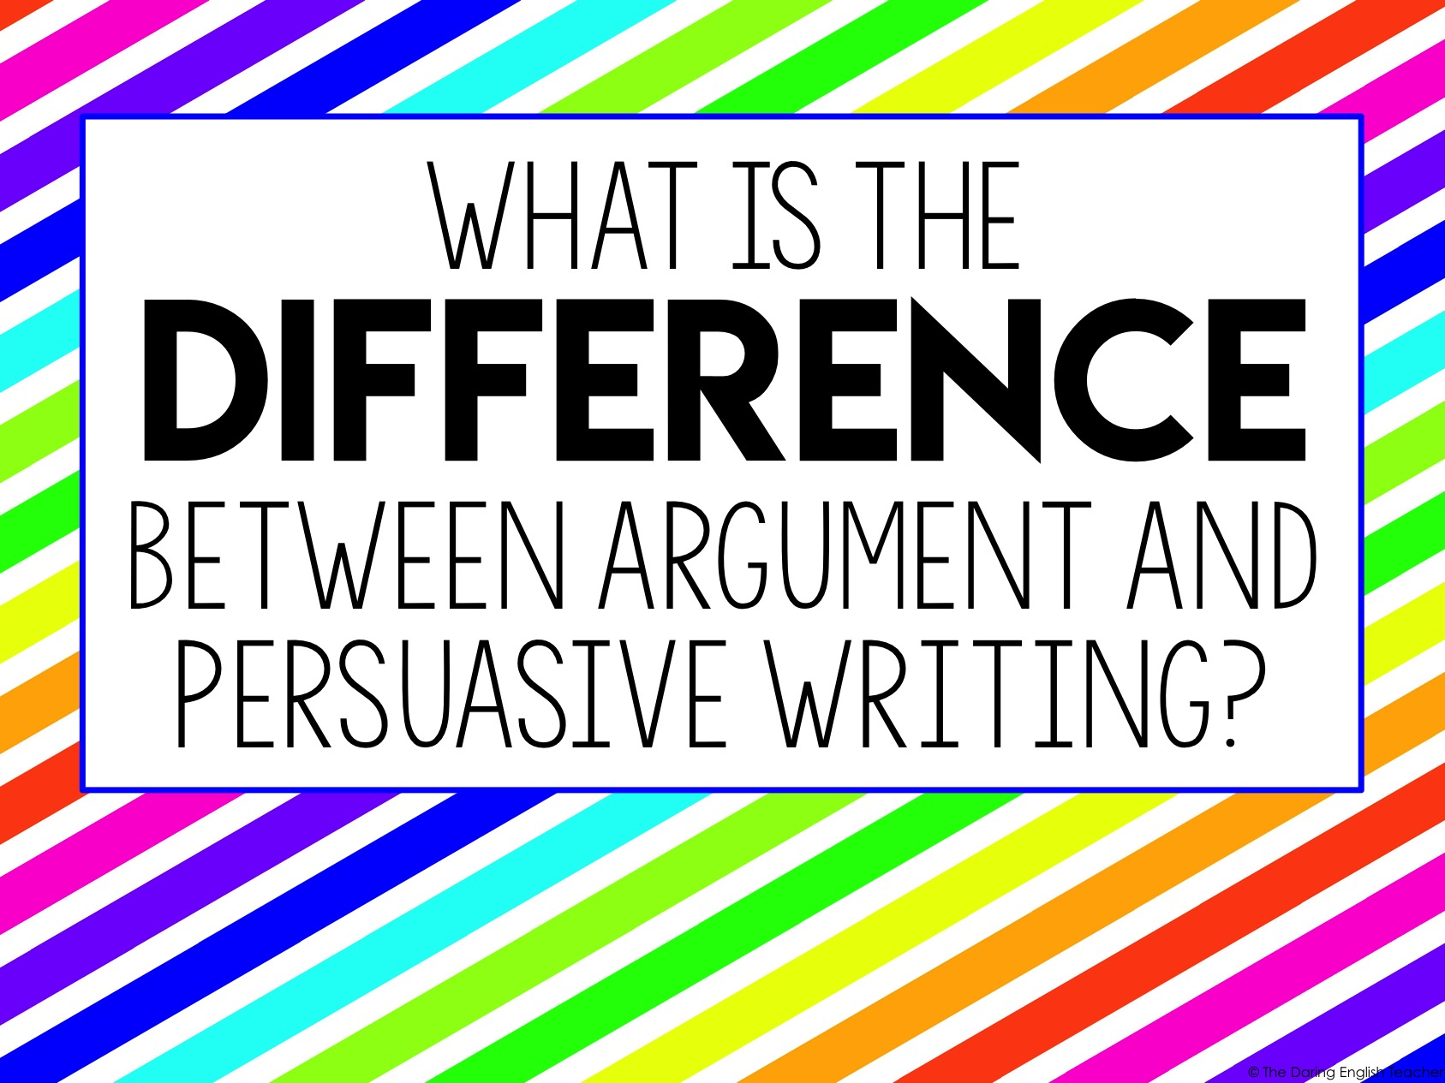
What is the
Difference between argument and persuasive writing?

Slide 5
Argument vs. Persuasive Writing
While the objective of argumentative writing is to persuade the audience that your side, or claim, is valid, there are some key differences between persuasive and argumentative writing.
Let’s look at the differences.

Slide 6
Argumentative vs. Persuasive Writing
Argumentative Writing | Persuasive Writing
GOAL: Convince the audience that your claim is valid | GOAL: Persuade the audience to agree with you
GETTING STARTED: Conduct research about a topic, and then form a claim | GETTING STARTED: Know your opinion and claim from the beginning
THE CLAIM: Based off opinion AND relevant and sufficient evidence | THE CLAIM: Based on opinion. It may or may not be substantiated.
ETHOS: Established through subject matter knowledge (be an EXPERT on your subject) | ETHOS: Included, but author may not present relevant and sufficient evidence to be considered an expert
PATHOS: Included, but the author relies more on evidence than emotional appeal | PATHOS: author relies heavily on the appeal to the audience’s emotions
LOGOS: Established through relevant and sufficient reasoning and evidence | LOGOS: Included, but there may not be enough relevant or sufficient evidence
OTHER VIEWPOINTS: Must include opposing arguments (counterclaims) | OTHER VIEWPOINTS: May or may not include a counterclaim

Slide 7
Important Terms for YOUR writing
Purpose – the reason why you are writing
Audience – the people who will read your writing
Tone – the author’s attitude toward the subject
Diction – the author’s choice of words

Slide 8
Important Terms for Understanding Argumentative Writing
Context– The political, social, and/or historical, etc. climate during the time the piece was written
Subject – the topic that the writing is mostly about
Speaker/Author – the person who wrote and/or presented the piece

Slide 9
Purpose
Why are you writing this piece?
What are you trying to achieve?
Why did the author write the piece?
What was the author trying to achieve?

Slide 10
Audience
Who do you want to read your writing?
Who did the author want to read his/her writing?

Slide 11
Tone
How do you feel about the subject you are writing about?
What is your attitude toward the subject?
How does the author feel about his/her subject?
What is the author’s attitude toward the subject?

Slide 12
Diction
What words will you use to convey your tone?
What words will help you deliver the best message you can?
What words did the author specifically choose to convey his/her tone?
What words helped the author deliver a strong message?

Slide 13
The Rhetorical Triangle (This is helpful to understand someone else’s writing)
SPEAKER
CONTEXT
PURPOSE
SUBJECT
AUDIENCE

Slide 14
Let’s Practice
Directions: Identify all of the elements of the rhetorical triangle for the selection on the next slide. You are trying to determine these elements:
- speaker
- purpose
- audience
- subject
- context

Slide 15
The Gettysburg Address
Four score and seven years ago our fathers brought forth on this continent, a new nation, conceived in Liberty, and dedicated to the proposition that all men are created equal.
Now we are engaged in a great civil war, testing whether that nation, or any nation so conceived and dedicated, can long endure. We are met on a great battle-field of that war. We have come to dedicate a portion of that field, as a final resting place for those who here gave their lives that that nation might live. It is altogether fitting and proper that we should do this.
But, in a larger sense, we can not dedicate -- we can not consecrate -- we can not hallow -- this ground. The brave men, living and dead, who struggled here, have consecrated it, far above our poor power to add or detract. The world will little note, nor long remember what we say here, but it can never forget what they did here. It is for us the living, rather, to be dedicated here to the unfinished work which they who fought here have thus far so nobly advanced. It is rather for us to be here dedicated to the great task remaining before us -- that from these honored dead we take increased devotion to that cause for which they gave the last full measure of devotion -- that we here highly resolve that these dead shall not have died in vain -- that this nation, under God, shall have a new birth of freedom -- and that government of the people, by the people, for the people, shall not perish from the earth.

Slide 16
The Rhetorical Triangle For Abraham Lincoln’s Gettysburg Address speech
SPEAKER
President Abraham Lincoln
CONTEXT
PURPOSE
SUBJECT
AUDIENCE

Slide 17
The Rhetorical Triangle For Abraham Lincoln’s Gettysburg Address speech
SPEAKER
President Abraham Lincoln
During the U.S. Civil War
CONTEXT
PURPOSE
SUBJECT
AUDIENCE

Slide 18
The Rhetorical Triangle For Abraham Lincoln’s Gettysburg Address speech
SPEAKER
President Abraham Lincoln
During the U.S. Civil War
CONTEXT
PURPOSE
To dedicate some of the field as a final resting place for soldiers who gave their lives
SUBJECT
AUDIENCE

Slide 19
The Rhetorical Triangle For Abraham Lincoln’s Gettysburg Address speech
SPEAKER
President Abraham Lincoln
During the U.S. Civil War
CONTEXT
PURPOSE
To dedicate some of the field as a final resting place for soldiers who gave their lives
All U.S. citizens, people present at the speech
SUBJECT
AUDIENCE

Slide 20
The Rhetorical Triangle For Abraham Lincoln’s Gettysburg Address speech
SPEAKER
President Abraham Lincoln
During the U.S. Civil War
CONTEXT
PURPOSE
Even though the U.S. is experiencing a difficult time, this country and government, which was founded on liberty, will continue to exist.
To dedicate some of the field as a final resting place for soldiers who gave their lives
All U.S. citizens, people present at the speech
SUBJECT
AUDIENCE

Slide 21

Let’s get
Writing

Slide 22
Writing an Argumentative Essay
Step 1:
Investigate a topic
Collect and evaluate evidence (from all sides)
Try to not form an opinion until AFTER you have researched your topic.
Step 2:
Establish a position
(this will be your claim)
Learn as much as you can about your topic!

Slide 23
Writing an Argumentative Essay
Step 3:
Write your thesis
Step 4:
Begin outlining your essay
Include main & supporting details
Include relevant & sufficient evidence
Remember to cite your sources
Match up your evidence with your supporting details

Slide 24
Writing an Argumentative Essay
Step 5:
Begin your first draft
Some people find it helpful to start with the introduction, while other students have an easier time writing the body paragraphs first. Either is okay.

Slide 25
Writing an Argumentative Essay
Step 6:
Proofread, Peer Edit, and Revise
Step 7:
Write/type your final draft

